Slide 1
June 2018
Open exposure data (OED)

Slide 2
ISSUES With current approach to exposure data
The standard export from RMS is three tab delimited text files: Account / Location / Reinsurance
Account and Location “acc / loc” files are the predominant input into Oasis currently due to the large number of RMS users in the market
However there are issues with using acc / loc as a starting point. Specifically:
The location key from Risklink (LOCID) is not exported. (LOCNAME and LOCNUM are but there is no requirement for these to be unique within a portfolio)
The same is true for POLICYID, where only the POLICYNUM is exported. Any analysis across accounts (e.g. treaty reinsurance) will not work if there any non-unique references.
The format / fields are proprietary, so documentation is not available for non-RMS customers
The reinsurance export file doesn’t contain key fields that are needed for reinsurance modelling
The translation from acc/loc -> Canonical -> Oasis adds a level of complexity that is not helpful

Slide 3
Rationale for new MODEX exposure FORMAT
We conducted a customer survey of ModEx clients in Q4 2017. Relating to exposure data, customers wanted:
A better understanding of how exposures run through the model
The ability to systematically query exposure and results
Better documentation
In addition, we also needed:
A robust and documented exposure format that we can communicate to other partners
An exposure format that takes advantage of the full functionality of the Oasis FM

Slide 4
PLAN
We are developing a new:
Exposure input format (including reinsurance)
Exposure back-end tables
Results tables
The work is already well underway and is supported by:
Dedicated, Simplitium-funded, resource
Pro-active customers who volunteered to be involved from the outset
The AIR CEDE code-set based
The target is to release this to the community in Q3 2018

Slide 5
BENEFITS
Documented starting point for all users
Structured exposure and results DB for users to be able to access directly if they so wish
Transparency about how exposure input fields flow through to the Oasis financial model
Simplification for model developers (one standard set of fields / codes to incorporate within their key-server)
Less complexity within the Oasis mid-tier – potential performance benefits
An exposure structure that takes full advantage of the Oasis financial model capabilities

Slide 6
HIERARCHY
Portfolio: Group of accounts
Account: Group of policies. Can attach financial conditions at account level.
Policy (including layers)
Policy Special Conditions
Location
Location Coverage: Buildings, Other Buildings, Contents, BI

Slide 7
INPUT TABLES vs BACK-END TABLES
Account
Location
Reinsurance Info
Reinsurance Scope
AccountFinancials
Accounts
Cedants
ConditionFinancials
Conditions
FlexiAcc
FlexiLoc
FlexiPol
LOB
LocationDetails
LocationFinancials
Locations
LocCond
LocStepFunc
Policies
PolicyFinancials
PortAcc
Portfolios
Producers
ReinsAcc
ReinsLoc
ReinsPol
ReinsReinstatements
ReinsuranceInfo
ReinsuranceScope
StepFunctions
WorkersComp

Slide 8
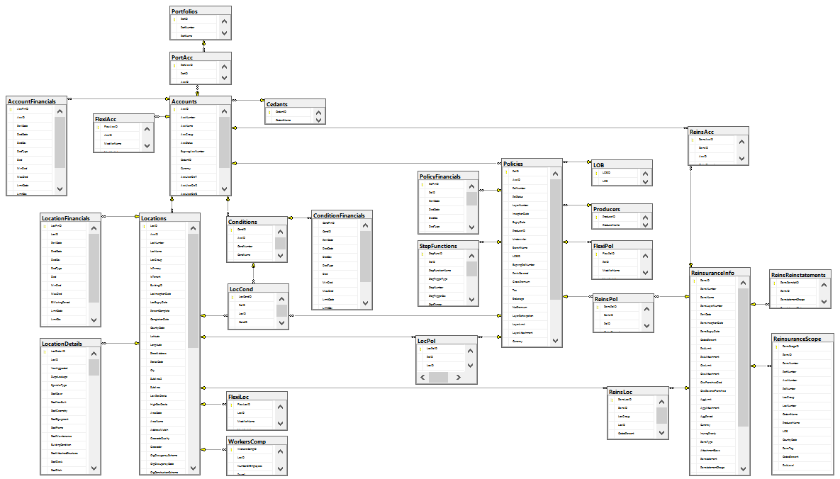
Database schema

Slide 9
GEOGRAPHY
ISO 3166 country codes with some ‘tweaks’ + defined offshore codes from AIR’s derived offshore regions
Fields available to store address info:
Country code
Longitude
Latitude
Street address
Postal code
City
Fields available for geocoding info:
Geocode Quality
Address Match
Geocoder
Area code
Area name
Sub-area
Sub-area 2
High Resolution CRESTA
Low Resolution CRESTA

Slide 10
OCCUPANCY
AIR CEDE code set used:
http://www.air-worldwide.com/Documentation/Database/Cede/webframe.html#topic29.html
Used for Occupancy, Construction, Secondary Modifiers, Country codes, Currency codes
Occupancy / construction codes are mapped directly to OED codes (one to one mapping from AIR)
With some minor changes as follows:
Occupancy:
New codes added:
IFM Solar panel plant
IFM Wind plant
Hotels – Small & medium
Hotels – Large
Casinos
Hospitals
Nursing homes
Museums
Convention centre
Exhibition hall
Library
Prison / jail
Detailed ACORD offshore occupancies (22 codes)
Removed codes:
Construction/Erection Risks: miscellaneous, residential, commercial, industrial

Slide 11
CONSTRUCTION / COUNTRY CODES
Construction code changes:
New codes:
Automobiles, Personal
Automobiles, Commercial
Removed codes:
Uninsurable construction, used only in Research model code (internal use only)
Country codes – based on ISO 3166 standard & AIR’s division of offshore regions:
Renamed 33 codes:
Offshore codes changed to 2 character combinations (from 3 letters): a letter + a number to distinguish from land countries
Removed 1 code:
AN = Netherlands Antilles
Added 6 codes:
XB = Bonaire
CW = Curacao
XS = Saba
XE = St. Eustatius
SS = South Sudan
WW = worldwide – to allow flexibility to record exposures with no address, which will not be used for modelling.

Slide 12
SECONDARY MODIFIERS / CURRENCY CODES
Secondary modifiers:
Added additional allowed value for:
Basement
Roof cover
Roof geometry
Roof Attached structure
Wall attached structure
Appurtenant structure
Building shape
Cladding
Roof Anchorage
Extra modifiers beyond AIR schema, e.g.
Building type
Construction quality
Sprinkler type
Year upgraded
Roof equipment
Ground equipment
Valuables storage
Fatigue
Roof maintenance
Flashing
Contents Wind / Earthquake Vulnerability, etc.
Currency codes are based on ISO4217 standard:
Renamed code: BYN from BYR
Added 24 codes:
To cover older currencies (e.g. prior to EUR) – allows maximum flexibility
New currency (e.g. SSP = South Sudan Pound)

Slide 13
Financial conditions
Sum insured: Buildings, Other Buildings, Contents, BI
Deductibles / limits applicable to Building, Other Building, Contents, BI, Property damage or site/blanket levels.
Deductibles:
Various options:
Per occurrence or annual
Franchise deductibles
Non ranking excess
Residual deductibles
Homeowner’s Standard or Choice deductibles
Different types: percentage of TIV or percentage of loss or amount
Limits:
Ability to define per occurrence or aggregate limits
Amount or percentage of loss limits
Special Conditions:
Ability to deal with nested conditions, e.g. California EQ sublimit and US sublimit
Ability to store overlapping conditions, e.g. Tier 1 Wind, Texas wind -> not in Oasis FM

Slide 14
Financial condition Examples
See the following worked examples:
Location coverage limits and deductibles (as values): FM3_Worked_example_policy_calculation_Modex.xlsx
Franchise deductibles: FM10_Worked_examples_Franchise deductible_Modex.xslx
Deductibles and limits as percentage of loss: FM11_Worked_example_DedAndLimPercentageOfLoss_Modex.xlsx
Special conditions: FM12_Worked_example_policy_calculation_Special conditions_Modex.xlsx
Reinsurance: FM23_LocFAC_xs_of_loss_Reinsurance_Modex.xlsx
Nested special conditions: OasisFM_2018_1_USHU_Tier1sublimit_ModEx.xlsx
Multiple sublimits (including nested): OasisFM_2018_4_Multiple_sublimits_ModEx.xlsx

Slide 15
NEXT STEPS
Open Results Data (ORD)
Documentation
Validation rules
Implementation in Oasis (by Oasis LMF)
Implementation in ModEx UI
Target timescale for above items is end-September
OED SQL integration with ModEx by year end

